Slide 1
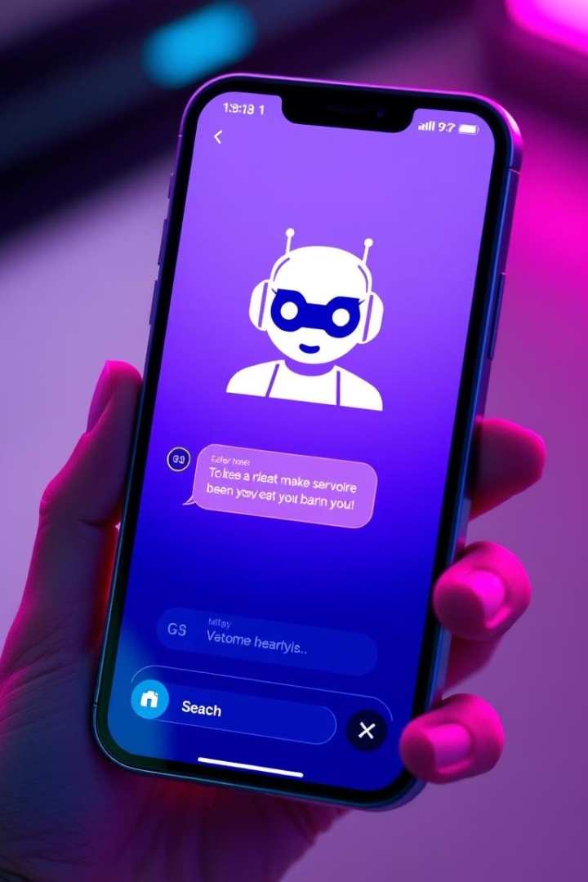

ShopBot: AI-Powered E-commerce Chatbot
Revolutionizing e-commerce through AI-powered shopping assistance
Made by: Vatsal Srivastava
by Vatsal Srivastava

Slide 2
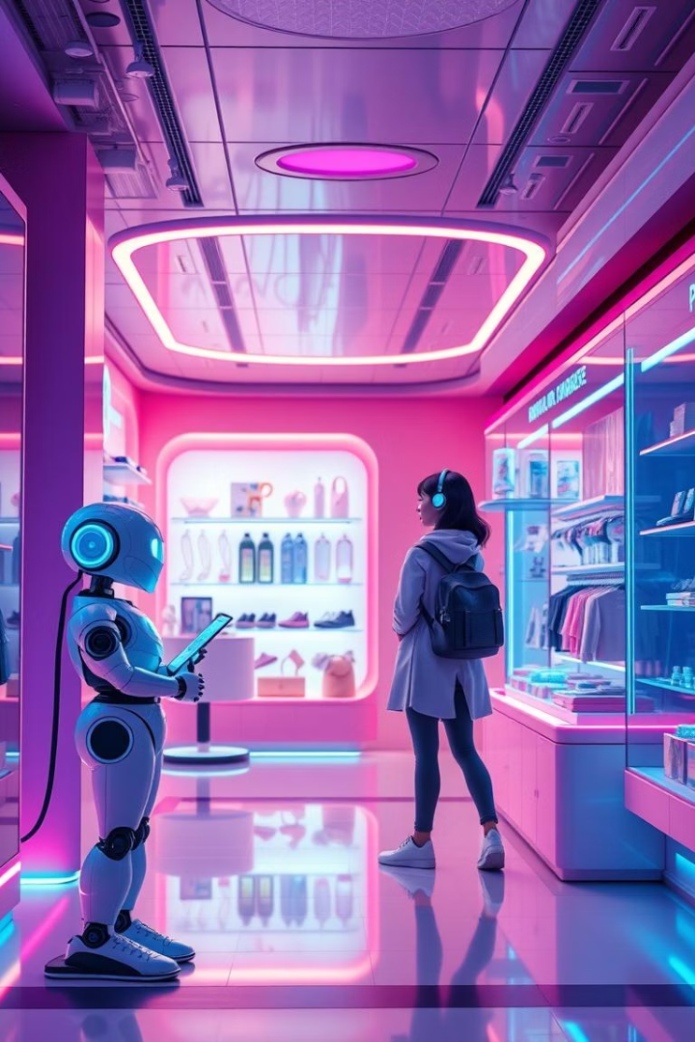
Overview: The Future of E-commerce is Here
Intelligent Chatbot
ShopBot enhances shopping experiences around the clock.
Efficient Support
Addresses customer needs with 24/7 availability.
Consumer Preference
67% of consumers prefer chatbots for support (Juniper Research, 2023).
Boost Engagement
Aims to increase customer engagement and drive sales.

Slide 3





Key Features
Natural Language Processing
Personalized Recommendations
Order Tracking
Real-time updates on order status.
Understands customer queries accurately.
AI suggests products based on browsing history.
Payment Integration
Secure transactions with Stripe and PayPal.

Slide 4

Benefits: Transforming the Customer Journey
15%
Increased Sales
Personalized recommendations drive higher sales.
30%
Reduced Costs
Automates customer service operations.
25%
Enhanced Satisfaction
Quick responses improve customer happiness.
True
Improved Insights
Gathers data for better marketing and product.

Slide 5
Technology: The Engine Behind ShopBot
AI Engine
Cloud-Based Infrastructure
API Integrations
Security Compliance
Uses TensorFlow and Python for advanced NLP.
Connects with Shopify, Magento, WooCommerce.
Adheres to GDPR standards.
Scalable and reliable on AWS.
Powers machine learning capabilities.
Also integrates with BigCommerce.
Complies with PCI DSS for data security.
Ensures high availability.

Slide 6
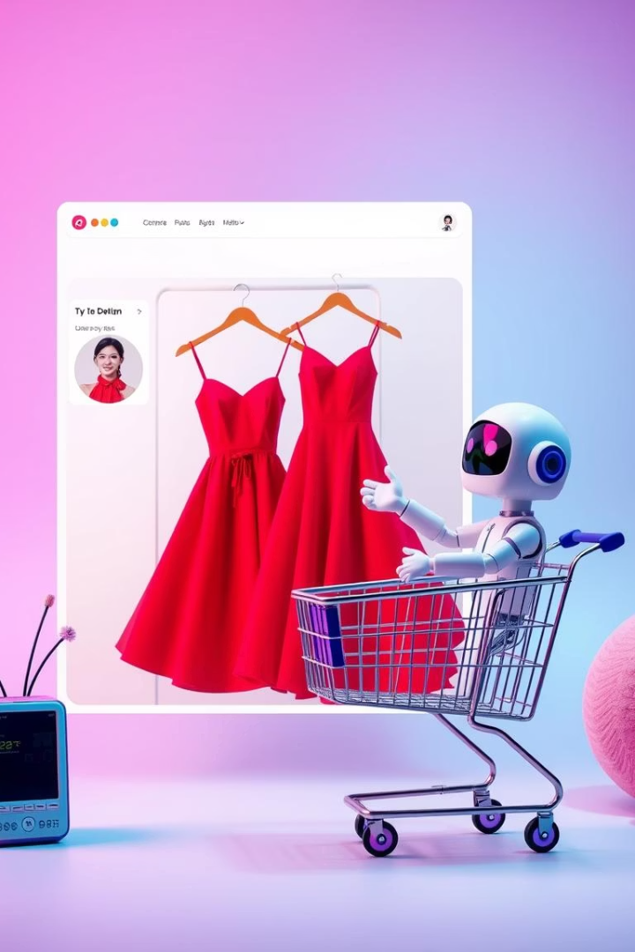



Use Cases: Real-World Applications
Product Discovery
Guides customers to the right items.
Customer Support
Answers FAQs and resolves issues instantly.
Marketing Campaigns
Promotes special offers and new arrivals.
Example: "Find me a red dress under $100."

Slide 7




Demo: See ShopBot in Action
Showcase Key Features
Real-time Interaction
A short video highlights ShopBot's core functionalities.
1
Experience direct interaction with the chatbot.
2
Practical Examples
High Accuracy
4
See order status and product recommendations.
Achieves 90% accuracy in query resolution.
3
Observe customer support in action.

Slide 8



Roadmap and Conclusion
Voice Integration
Enabling voice commands and responses.
AR/VR Support
Integrating augmented and virtual reality.
Multilingual Capabilities
Expanding language support globally.
Call to Action:
Partner with us to revolutionize your e-commerce business.
Contact Information:
Vatsal Srivastava, srivastavavatsal548@gmail.com

